Slide 1
Lecture 12 – Generative Adversarial Networks
Prof. André Gustavo Hochuli
gustavo.hochuli@pucpr.br
aghochuli@ppgia.pucpr.br
Notes:
Prof. André Hochuli

Slide 2
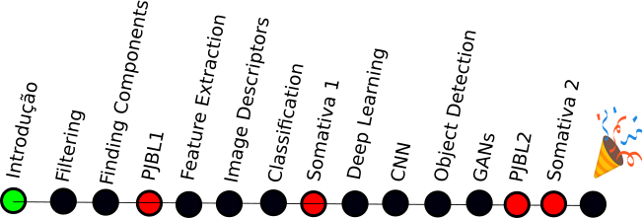
Topics
Review of Lecture 11 – Image Segmentation
Object Segmentation (Bounding Box Level)
Instance / Semantic Segmentation (Pixel Level)
Generative Adversarial Networks
DCGAN
PIX2PIX
Practice
Computer Vision - Prof. André Hochuli
Lecture 12
Notes:
Prof. André Hochuli

Slide 3
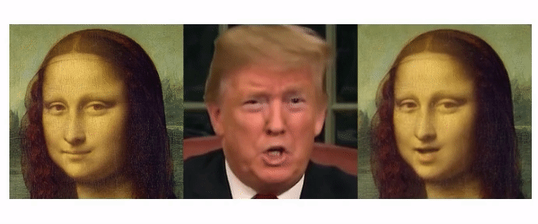
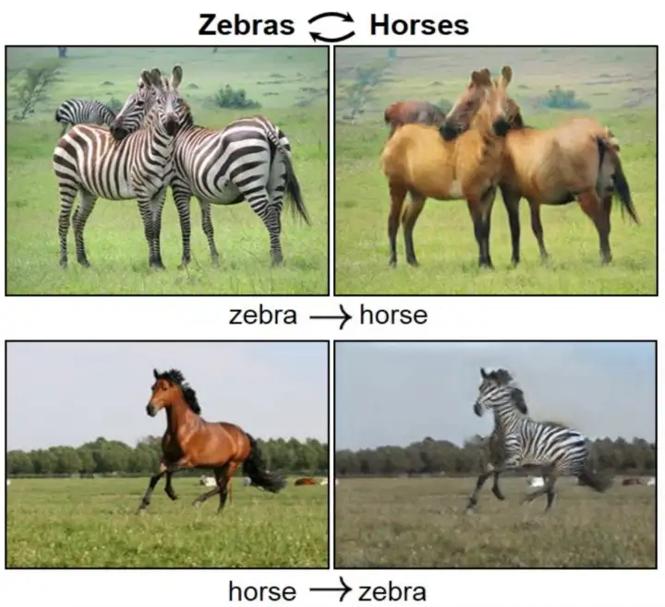
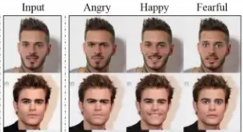
Deep Fakes
Generalization: Synthetic data produced from the learning of real data distribution
Several Applications
Movies (Fake Scenes)
Photo Enhancement (Pose Estimation, Gray2Color, Noise Reduction)
Image Translation
……….
Computer Vision - Prof. André Hochuli
Lecture 12
Notes:
Prof. André Hochuli

Slide 4
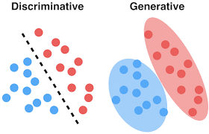
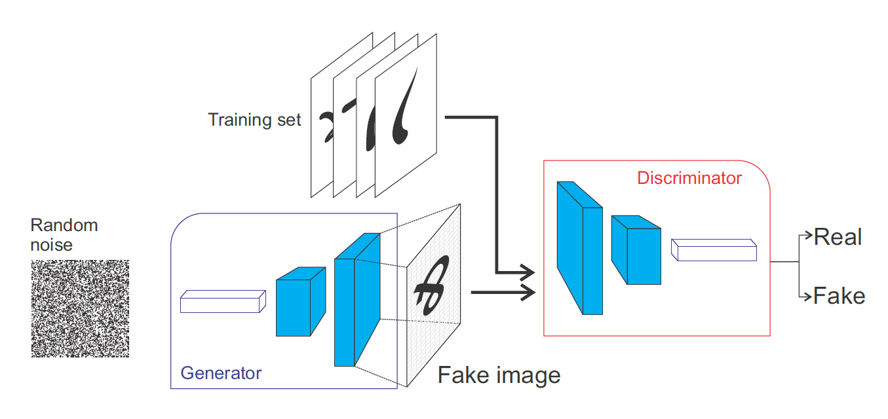
Generative Adversarial Networks (GAN’s)
Generator: Noise → Data
Discriminator: Classification
Computer Vision - Prof. André Hochuli
Lecture 12
Notes:
Prof. André Hochuli

Slide 5
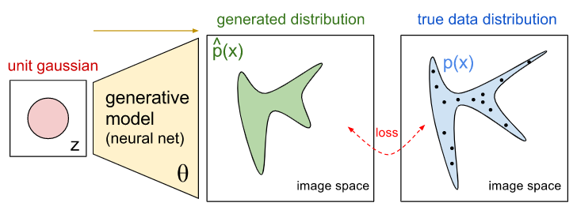
Generative Model
Learns data distribution
Computer Vision - Prof. André Hochuli
Lecture 12
Notes:
Prof. André Hochuli

Slide 6
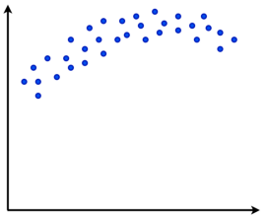
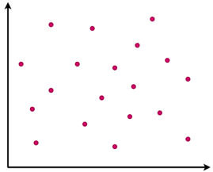
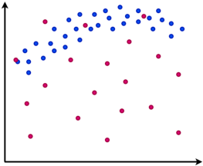
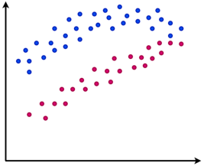
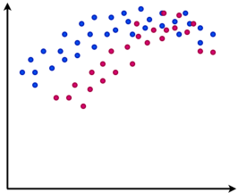
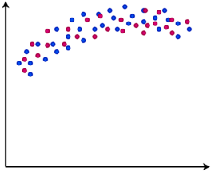
Generative Model
Real
Fake
Training
Computer Vision - Prof. André Hochuli
Lecture 12
Notes:
Prof. André Hochuli

Slide 7
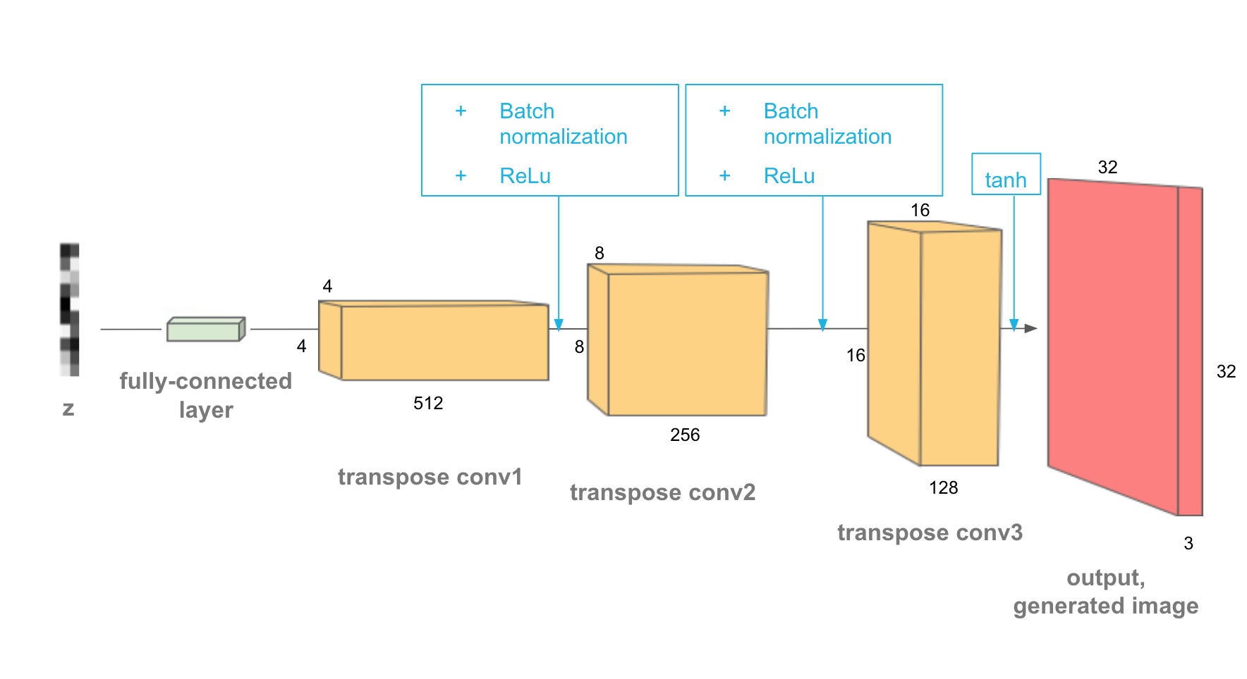
Deep Generative Model
De-Convolutional Layers (upsampling)
Noise to Fake Image
Computer Vision - Prof. André Hochuli
Lecture 12
Notes:
Prof. André Hochuli

Slide 8
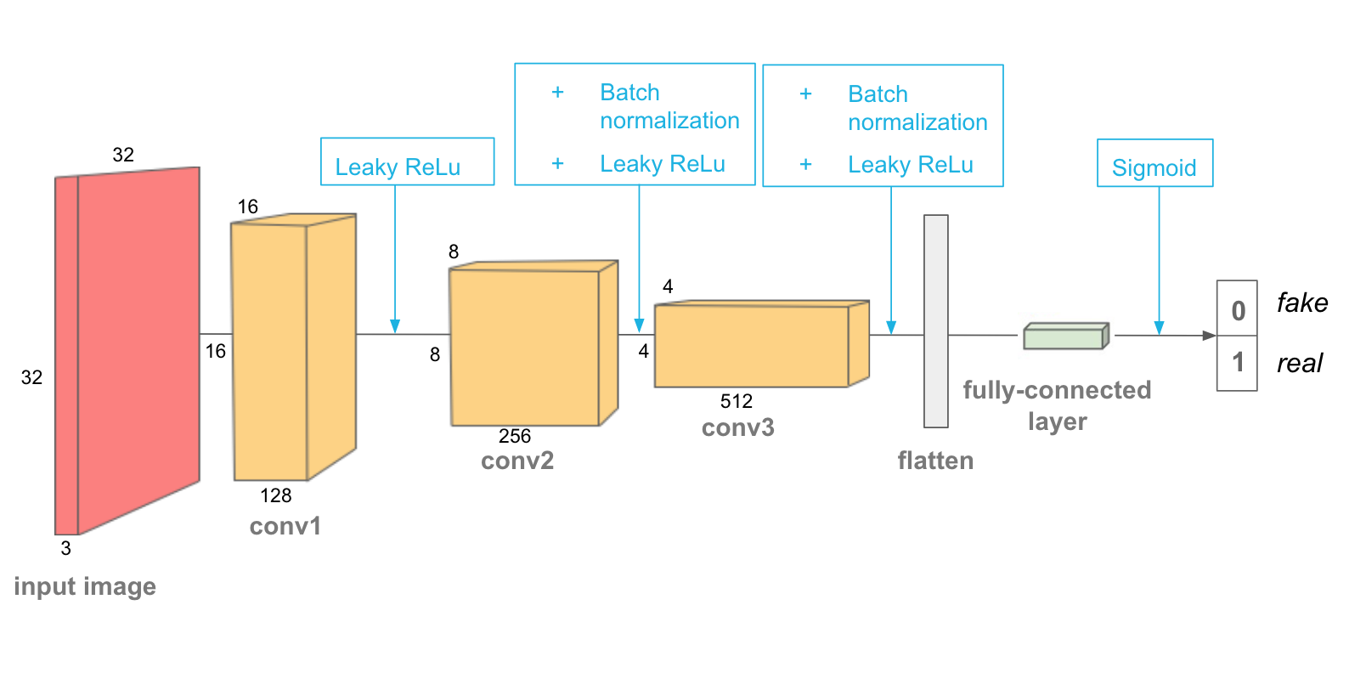
Discriminator Model
Classification: Fake or Real
CNN
Computer Vision - Prof. André Hochuli
Lecture 12
Notes:
Prof. André Hochuli

Slide 9
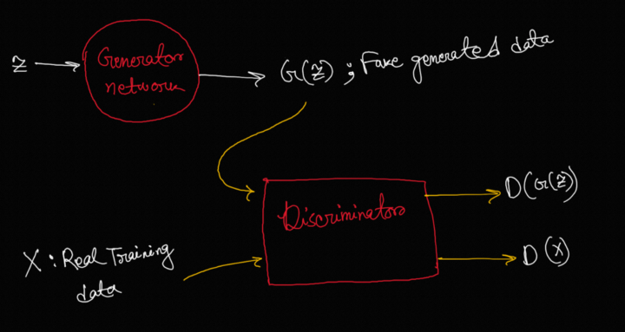
Adversarial Training
Adversarial Loss (Min-Max)
Minimize Generator
Maximize Discriminator
Computer Vision - Prof. André Hochuli
Lecture 12
Notes:
Prof. André Hochuli

Slide 10
Let’s Code
LINK: Lecture_12-DCGAN.ipynb
Computer Vision - Prof. André Hochuli
Lecture 12
Notes:
Prof. André Hochuli

Slide 11
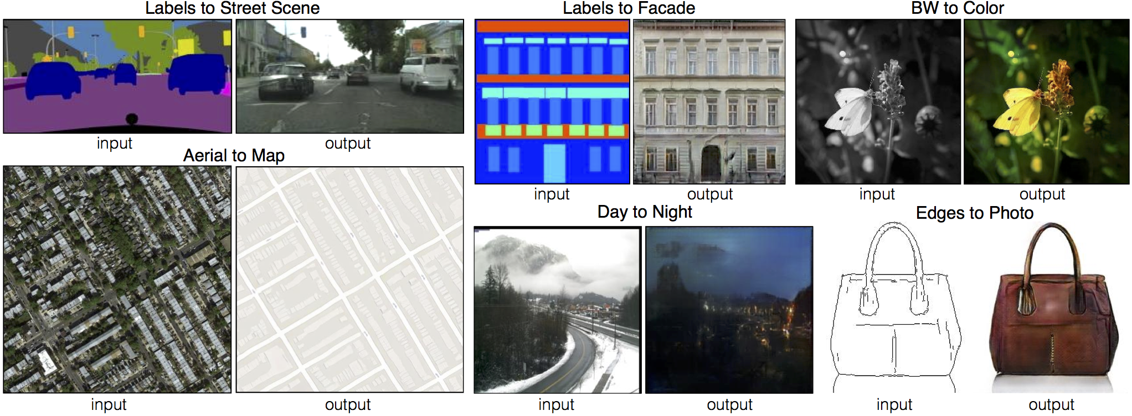
Pix2Pix
Image-Translation
Computer Vision - Prof. André Hochuli
Lecture 12
Notes:
Prof. André Hochuli

Slide 12
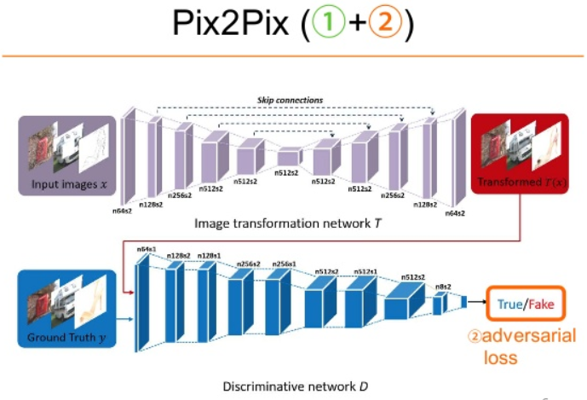
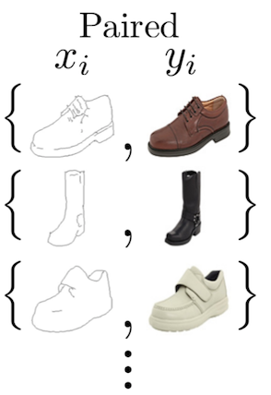
Pix2Pix
Generative Model: Encoder-Decoder Architecture (i.e U-Net)
Paired Annotated Dataset
Computer Vision - Prof. André Hochuli
Lecture 12
Notes:
Prof. André Hochuli

Slide 13
Let’s Code
LINK: Lecture_12-pix2pix.ipynb
Computer Vision - Prof. André Hochuli
Lecture 12
Notes:
Prof. André Hochuli

Slide 14
Course Final Remarks
12 Lectures / Topics
Image Processing
Image Segmentation
Image Classification
Feature Extraction
Shallow Classification
Deep Learning
Classification
Segmentation
GANs
04 assessment
Implementation Tasks:
Plate Recognition, Deep Learning
Exam-Based
Image Processing, Filter, Feature Extraction
CNN, Feature Learning, TransferLearning, Segmentation, Generative)
Computer Vision - Prof. André Hochuli
Lecture 12
Notes:
Prof. André Hochuli

